Slide 1
Using Components 2D Vector Analysis
The Components of a Vector
Adding and Subtracting Vectors using components

Slide 2
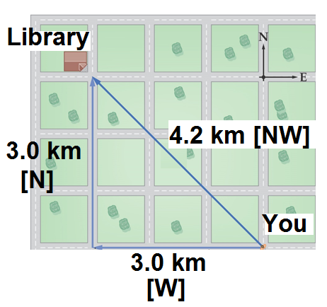
The Components of a Vector
Consider the diagram below: The library is 4.2 km [NW] of your location. How will you get there?

Slide 3
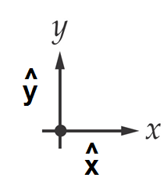
Cartesion Components:
In a 2D plane, we can define a co-ordinate system made up of 2 orthogonal (________________) unit vectors:
We can ____________ or _____________ any vector in a 2D plane into _______________ in each unit vector direction:

Slide 4
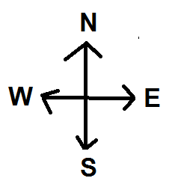
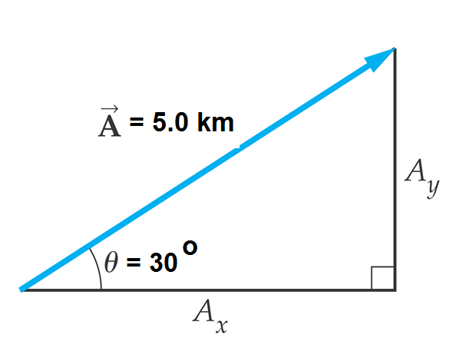
Position vector Vector A can be written two ways:

Slide 5
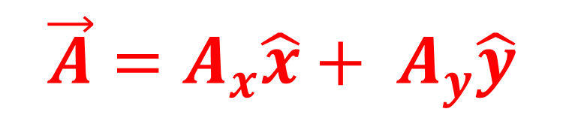
We can find the values of Ax and Ay using Trig!
$$\vec{A}=A_{x}\hat{x}+ A_{y}\hat{y}$$

Slide 6
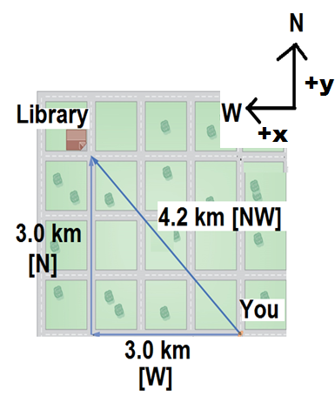
The Components of a Vector
Back to the library displacement! We can represent the displacement using components!

Slide 7
Adding vectors using components!
Find the x and y components for each vector:
Add up all of the x and y components:

Slide 8
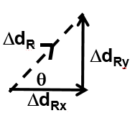
Sketch the total x and y components and use Pythagorean Theorem & SOHCAHTOA to write in magnitude angle form.

